Slide 1
MySQL
Day 06
Aggregate Functions

Slide 2
Aggregate Functions
An aggregate function is a function that operates on a group of values and returns a single value.
The group of values Is typically a set of rows in a table, but it can also be a set of values provided directly to the function.
Aggregate functions are often used in combination with the GROUP BY clause, which groups the rows of a table by one or more columns.
The aggregate function is then applied to each group separately, returning a single value for each group.
Some of the built-in aggregate functions in MySQL are,
i. COUNT()
ii. SUM()
iii. AVG()
iv. MAX()
v. MIN()

Slide 3
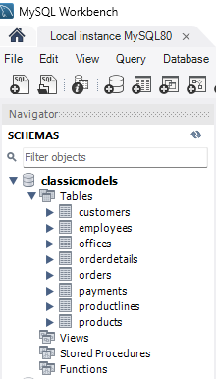
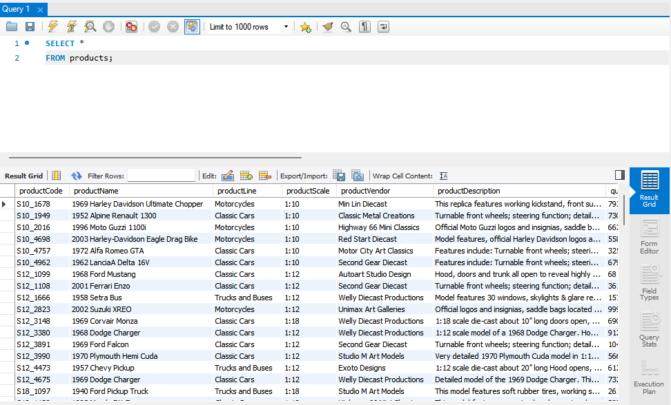
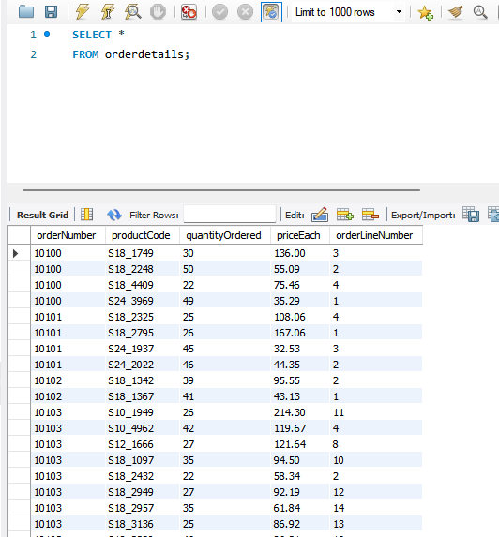
Database and Tables used.
We are using ‘classicmodels’ database that has multiple tables.
We are mostly using the ‘products’ table in this presentation.
We will also use ‘orderdetails’ in an example or two.

Slide 4
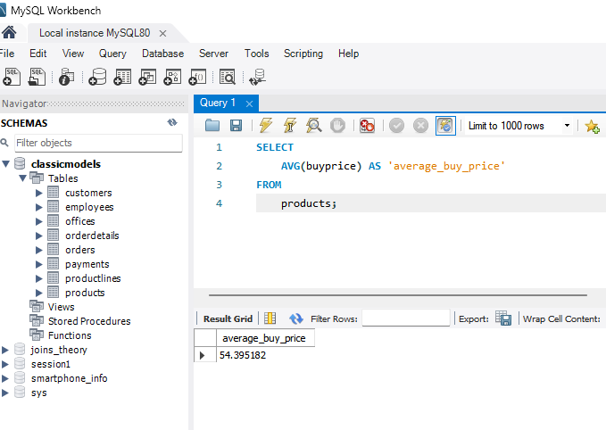
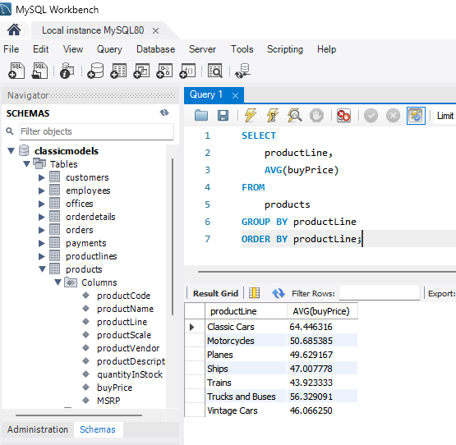
AVG()
The AVG( ) function calculates the average value of a set of values. It ignores NULL in the calculation.
Calculating average buy price of all products in the ‘products’ table by using AVG function.
Calculating AVG buy price for each product line in ‘products’ table using AVG function.
Notice the use of GROUP BY and ORDER BY.

Slide 5
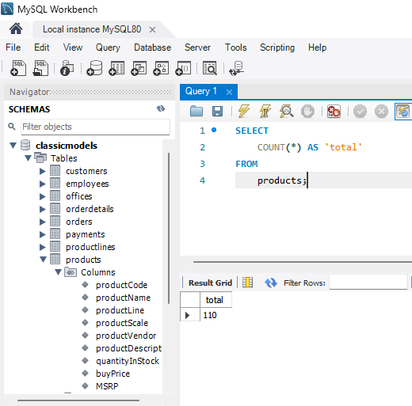
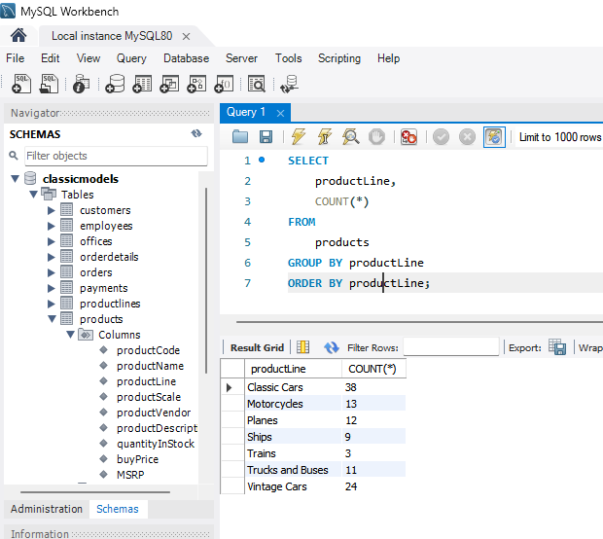
COUNT()
The COUNT( ) function returns the number of the value in a set.
Using COUNT() function to get the number of products in the ‘product’ table.
Using COUNT() function with the GROUP BY clause to get the number of products for each product line.

Slide 6
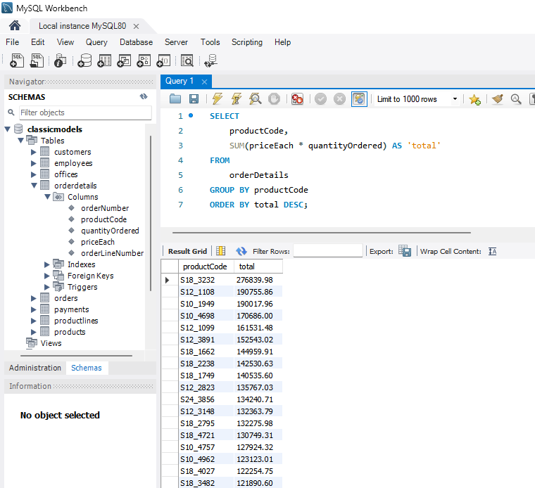
SUM()
The SUM() returns the sum of values in a set. It Ignores NULL. If no matching row found, SUM() returns NULL
Getting total value order of each product in table ‘orderDetails’ using SUM() function in conjunction with the GROUP BY clause.

Slide 7
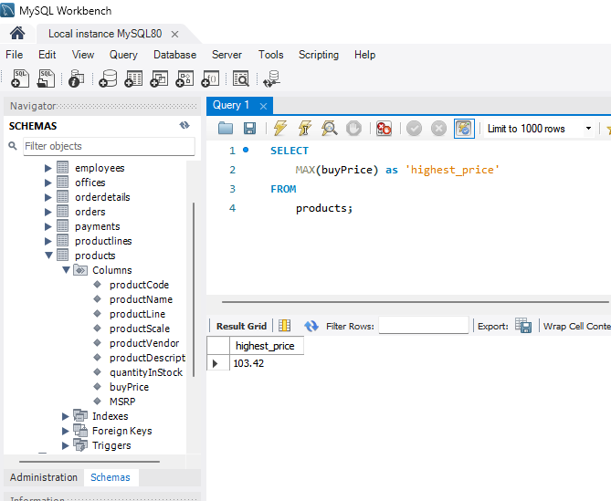
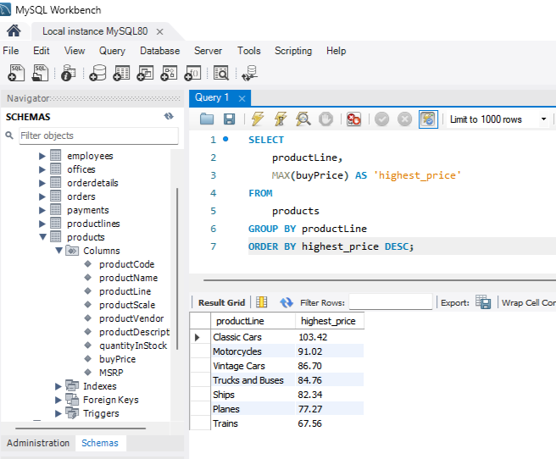
MAX()
The MAX() function returns the maximum value in a set.
Getting the highest price from the ‘products’ table using MAX() function.
Getting the highest price per product line using the MAX() function with the GROUP BY clause.

Slide 8
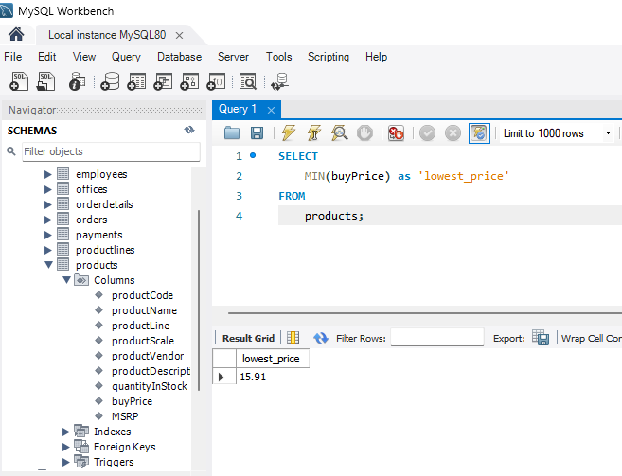
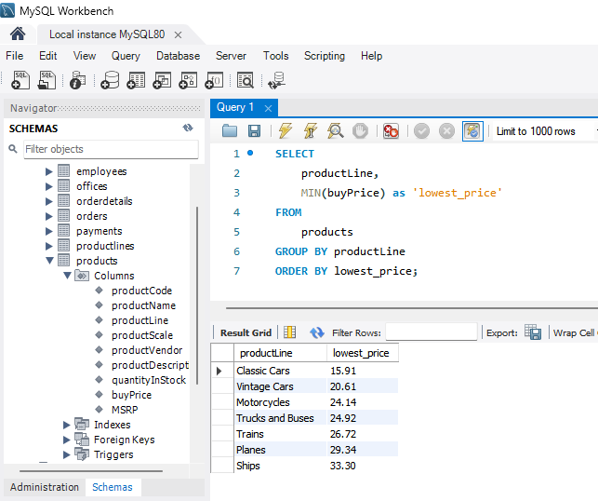
MIN()
The MIN() function returns the minimum value in a set.
Getting the lowest price from the ‘products’ table using MIN() function.
Getting the lowest price per product line using the MIN() function with the GROUP BY clause.

